Slide 1
KCGL ERP - Letter Send
How employees send official letters to customers from the ERP
Covers three sections:
1. Send a Letter - warranty lapse / CSP letters on the company letterhead, sent by email as PDF
2. Letter History - every letter of a customer with its status
3. Dashboard Letter Report - the letters sent by you, with view / download / print
Also explains the Maintenance Chart (Service Cycle) and DG Set / Sticker details in the letter
Every step has a screenshot with red markers ①, ②, ③ showing exactly where to click

Slide 2
Letter Send Guidelines and Terminologies
Module | Customer Engagement - Letter Send
Purpose | Send formal letter-headed PDF letters (warranty lapse / CSP follow-up) to customers by email, with the maintenance chart and DG set details, and keep the full history of every letter
Intended Users | Employees taking customer follow-ups
Format Type | The letter type (e.g., Preventive Maintenance Schedule - Warranty Compliance Notice, CSP Follow Up). Each type has its own Ref No series and default attachments
Ref No | Auto-generated letter number (e.g., KCGL/26-27/CSP/Branch/Serial). It is reserved when the letter opens and stays the same for a draft
Service Cycle | The maintenance chart - KOEL Preventive Maintenance Guidelines table (Service Type, Schedule, Remarks) printed inside CSP letters
References | DG set details block in the letter - Instance ID, Application Code, Engine Model, KVA, Warranty Expiry etc.
Status | Draft (yellow) = saved, not sent · Sent (green) · Partial (orange) = sent with some issue · Failed (red)
Letter Report | Dashboard box showing the letters sent by you - with View / Download / Print

Slide 3
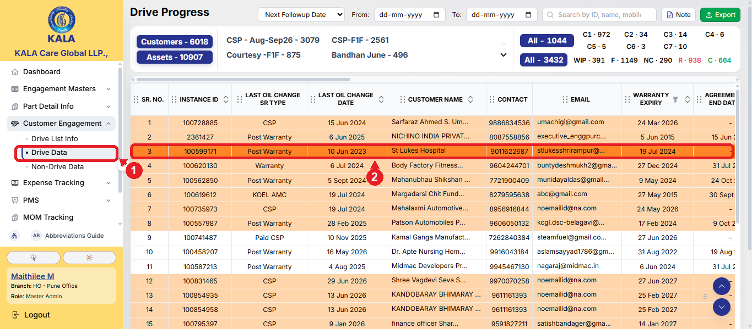
Letter Send Steps - Section 1: Send a Letter to the Customer
Step 1: Open the customer. In the left menu, expand Customer Engagement and click Drive Data ① (or Non-Drive Data). Click the customer to whom the letter is to be sent ②

Slide 4
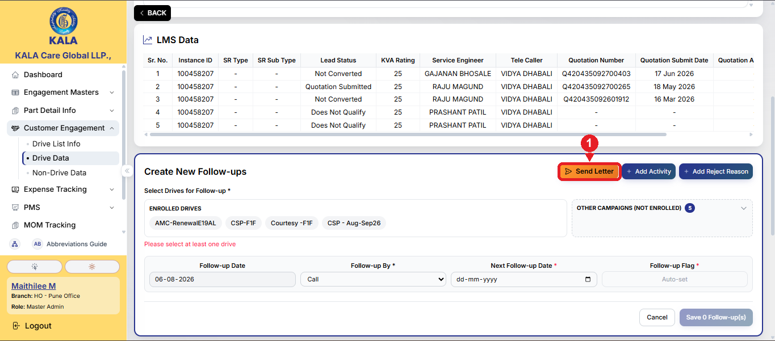
Letter Send Steps - Section 1: Send a Letter to the Customer
Step 2: On the customer page, go to the Create New Follow-ups box and click the orange Send Letter button ①. The Send Letter wizard opens with 3 steps - Format Type → Letter → Review & Send

Slide 5
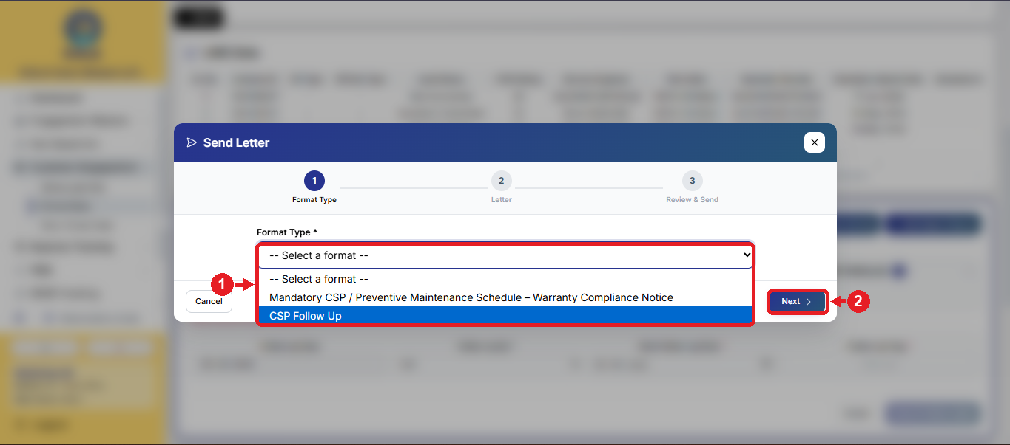
Letter Send Steps - Section 1: Send a Letter to the Customer
Step 3: Wizard Step 1 - select the Format Type from the dropdown ① - e.g., Mandatory CSP / Preventive Maintenance Schedule - Warranty Compliance Notice, or CSP Follow Up. The product, reference number series and default attachments of that format are set automatically. Click Next ②

Slide 6
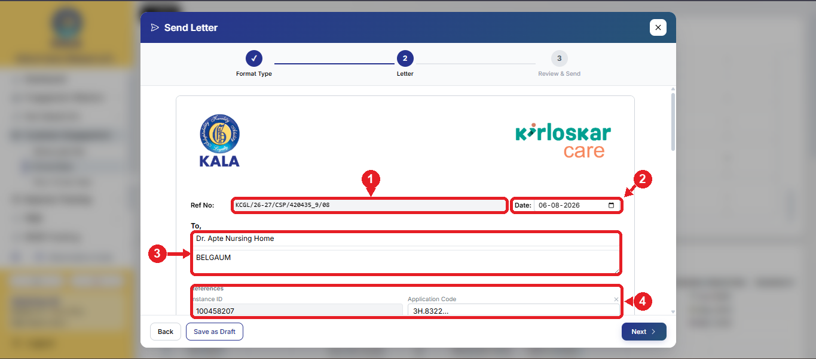
Letter Send Steps - Section 1: Send a Letter to the Customer
Step 4: Wizard Step 2 - the letter opens on the company letterhead. The Ref No ① is auto-generated and locked. Check the Date ②, the customer name and address (To) ③, and the References ④ - the DG set details like Instance ID, Application Code, Engine Model, KVA. For CSP letters the SR Subtype and SR Number are added automatically

Slide 7
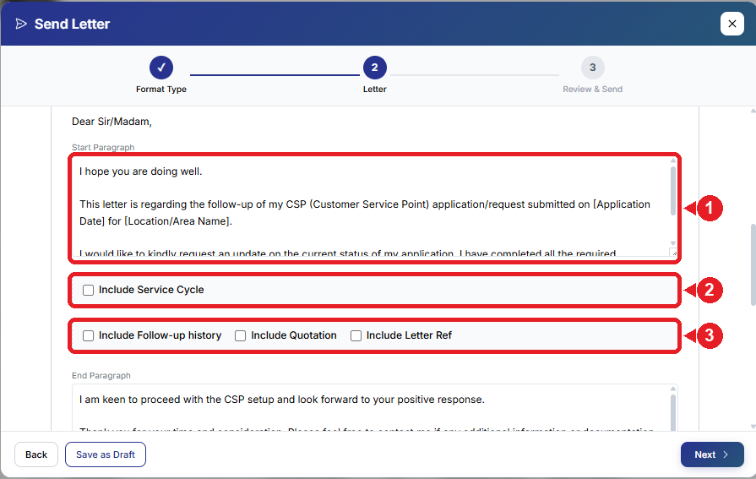
Letter Send Steps - Section 1: Send a Letter to the Customer
Step 5: Edit the Start Paragraph ① if required - the ready text already covers the DG set warranty / AMC expiry. Tick Include Service Cycle ② to print the maintenance chart (KOEL Preventive Maintenance Guidelines) in the letter - its rows can be edited. Use Include Follow-up history / Include Quotation / Include Letter Ref ③ to add those tables. The End Paragraph can also be edited

Slide 8
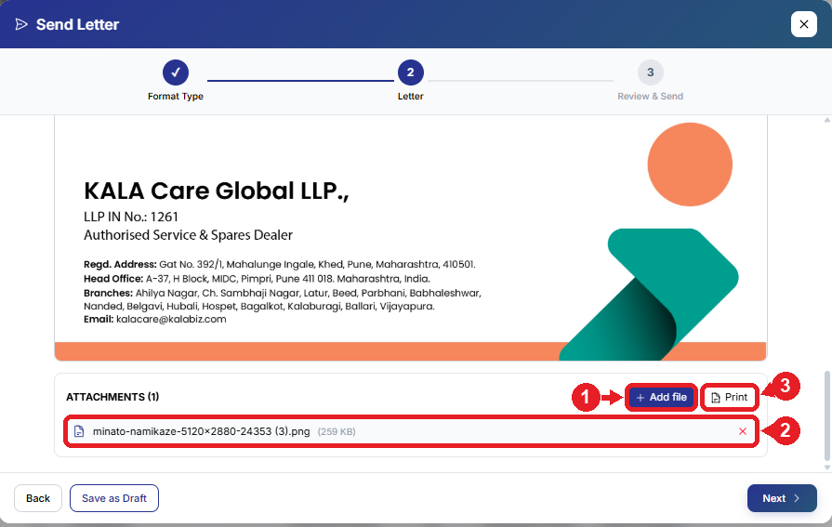
Letter Send Steps - Section 1: Send a Letter to the Customer
Step 6: Scroll down to Attachments. Click Add file ① to attach the DG sticker image, quotation or any document (jpg / png / pdf / doc / xlsx). Attached files appear in the list ② and can be removed with ✕. Use Print ③ to print the letter directly. The default attachments of the chosen format are added automatically

Slide 9
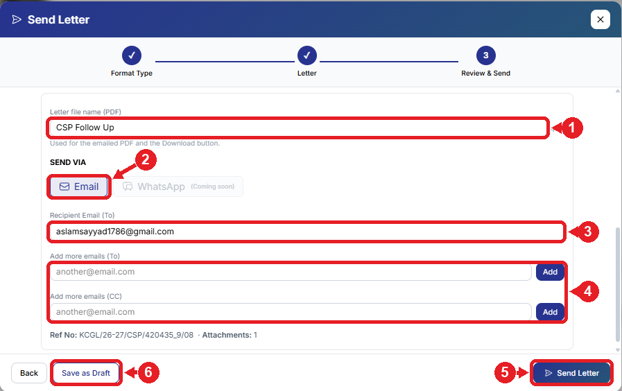
Letter Send Steps - Section 1: Send a Letter to the Customer
Step 7: Wizard Step 3 - Review & Send: check the letter preview and the PDF file name ①. Send via Email ② (WhatsApp - coming soon). The customer's email is pre-filled in Recipient Email ③; more To / CC emails can be added ④ - the branch CC emails are added automatically. Click Send Letter ⑤ to send the letter as a PDF, or Save as Draft ⑥ to complete it later

Slide 10
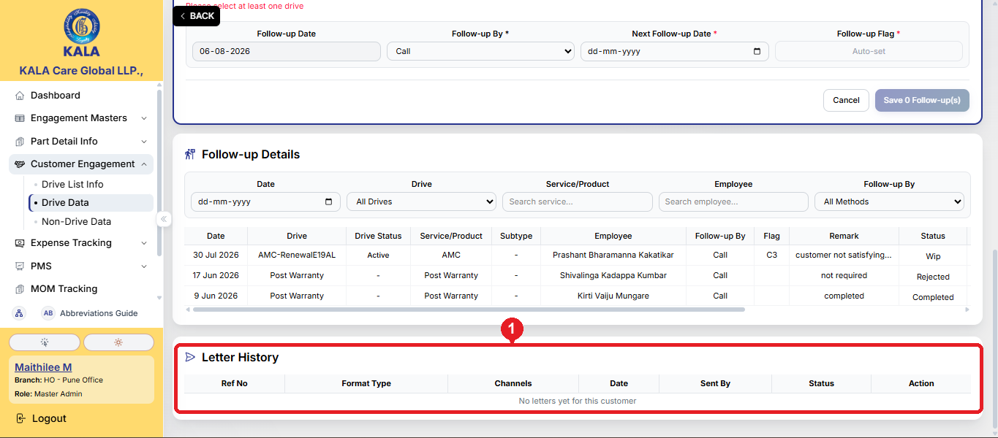
Letter Send Steps - Section 2: Letter History of the Customer
Step 1: Scroll to the bottom of the customer page - Letter History ① shows every letter of this customer: Ref No, Format Type, Channels, Date, Sent By and Status (Sent = green, Draft = yellow). Click a Draft's Ref No to reopen and complete it; click the eye icon to view a sent letter. A sent letter cannot be edited again

Slide 11
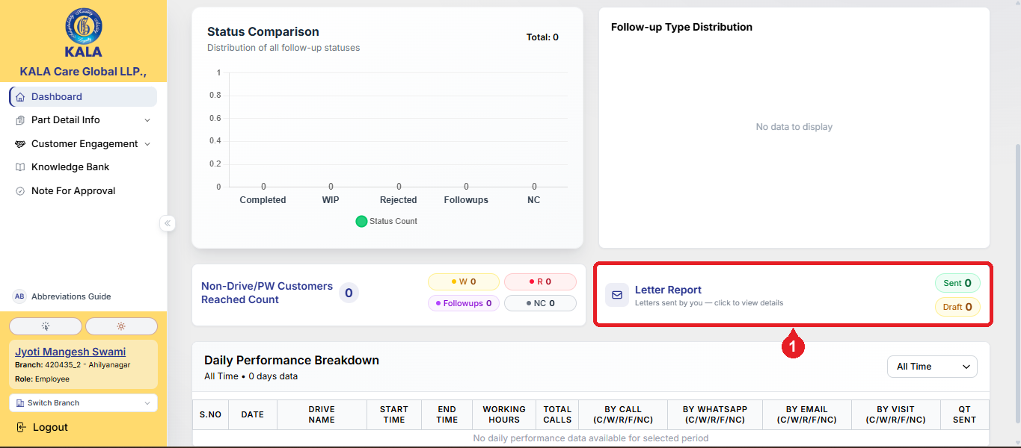
Letter Send Steps - Section 3: Dashboard - Letter Report
Step 1: On the Dashboard, the Letter Report box ① shows the letters sent by you - Sent and Draft counts. Click the box to open the full report. The Letter For Warranty Lapse box in the CSP row shows the count of CSP letters sent by you - clicking it opens the same report filtered to CSP letters only

Slide 12
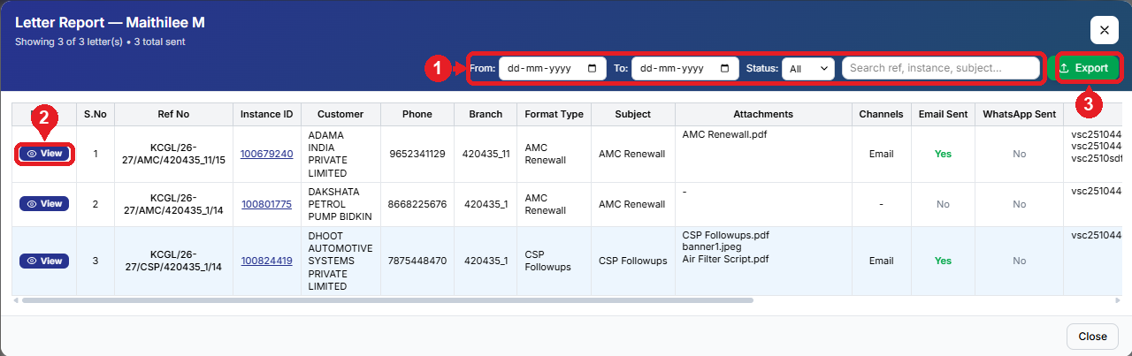
Letter Send Steps - Section 3: Dashboard - Letter Report
Step 2: The Letter Report lists all your letters with customer, branch, format type, subject, attachments and status. Filter by date / status or search by ref, instance or subject ①. Click View ② to open the letter PDF again - it can be downloaded or printed. Click Export ③ for the Excel report. Clicking an Instance ID opens that customer's page directly

Slide 13
Maintenance Chart & DG Set / Sticker Details in the Letter
Maintenance Chart (Service Cycle): In CSP letters, tick Include Service Cycle in the letter step. It prints the “KOEL Preventive Maintenance Guidelines” table in the letter - Service Type (A / B / C Check), Schedule and Remarks. The rows come pre-filled from the Letter Master and every cell can be edited, rows can be removed or added
DG Set Details: The References section of the letter automatically shows the DG set details of the customer - Instance ID, Application Code, Engine Model, KVA Rating, Warranty Expiry etc. Verify these details before sending; any wrong field can be corrected or removed with ✕ for that letter (Instance ID is always kept)
DG Sticker & Other Documents: Use Add file in the Attachments section to send the DG sticker image, service charts, quotation or any other document (jpg / png / pdf / doc / xlsx) along with the letter. The customer receives them together with the letter PDF in one email
Note: The ready letter text itself informs the customer that the AMC / warranty of their DG Set (with the engine model and expiry date filled automatically) is due to expire and requests renewal

Slide 14
Quick Reference
Situation | What to do
Send a warranty lapse / CSP letter | Open customer → Send Letter → choose Format Type → check letter → Review & Send
Save an unfinished letter | Save as Draft - reopen later from Letter History (the Ref No stays the same)
Add the maintenance chart in the letter | Letter step → tick Include Service Cycle → check / edit the KOEL schedule rows
Send the DG sticker / documents | Attachments → Add file (jpg / png / pdf / doc / xlsx)
See all letters of a customer | Customer page → scroll to Letter History at the bottom
See the letters sent by you | Dashboard → Letter Report box → View / Download / Print
See your CSP letters count | Dashboard → Letter For Warranty Lapse box → click to view the list
Do's and Don'ts
Do | Don't
Check the customer's email ID and the DG set details (References) before sending | Do not send a letter without checking the preview in Review & Send
Use Save as Draft if the letter is incomplete | Do not expect to edit a sent letter - complete it as a draft first, send once verified
Attach the required documents (DG sticker, quotation, chart) before sending | Do not use WhatsApp sending - it is not available yet, send by Email

Slide 15


